Slide 1
Microsoft Power BI

Slide 2
Intro to M Programming
Ted Pattison
Principal Program Manager
Power BI Customer Advisory Team (PBICAT)

Slide 3
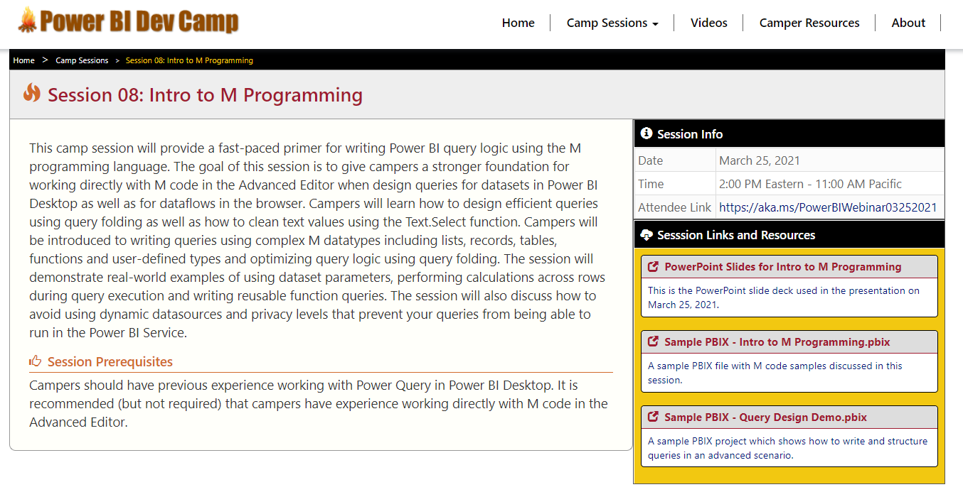
Welcome to Power BI Dev Camp
Power BI Dev Camp Portal - https://powerbidevcamp.net

Slide 4
Agenda
The Power Query Mashup Engine
M Programming Fundamentals
Programming Lists, Records and Tables
Understanding Query Folding
Choosing Between OData.Feed & Web.Contents
Writing Reusable Function Queries
Designing with Query Parameters

Slide 5
Power Query is an ETL Tool
ETL process is essential part of any BI Project
Extract the data from wherever it lives
Transform the shape of the data for better analysis
Load the data into dataset for analysis and reporting
CSV
File
Power Query
Mashup Engine
Power BI Desktop Project (PBIX)
Dataset
Excel
Workbook
OLTP
Database

Slide 6
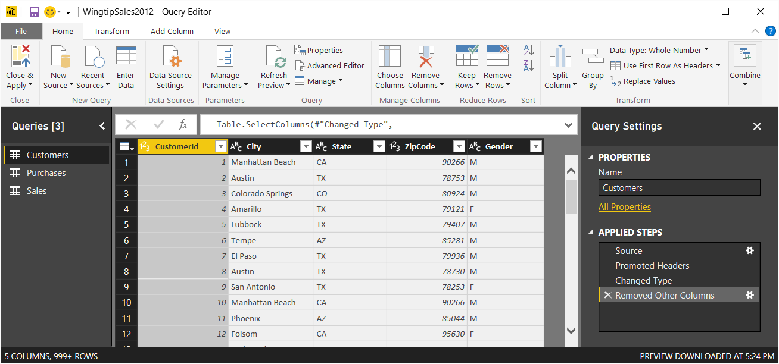
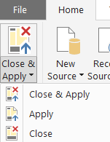
Query Editor Window
Power BI Desktop provides separate Query Editor window
Provides easy-to-use UI experience for designing queries
Queries created by creating Applied Steps
Preview of table generated by query output shown in the middle
Query can be executed using Apply or Close & Apply command

Slide 7
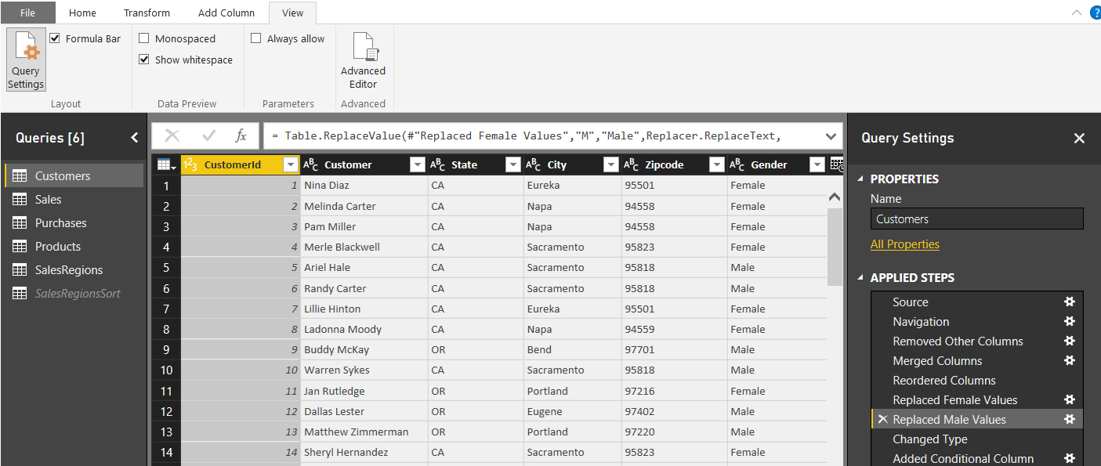
Query Steps
A query is created as a sequence of steps
Each step is a parameterized operation in data processing pipeline
Query starts with Source step to extract data from a data source
Additional steps added to perform transform operations on data
Each step is recorded using M (aka Power Query Formula Language)
step formula bar
sequential list of steps for query

Slide 8
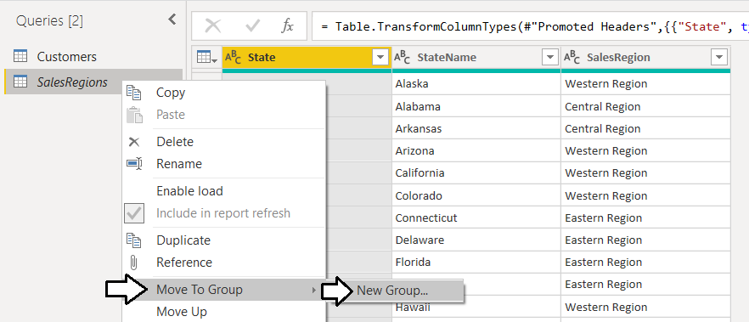
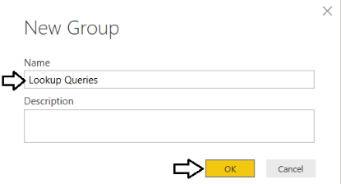
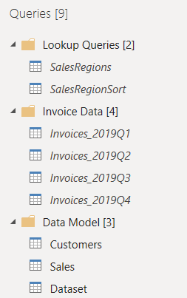
Structuring Queries into Folder Groups
Queries can be organized into folder groups
Folder groups can be created for similar types of queries
Makes it easier to manage project with large number of queries

Slide 9
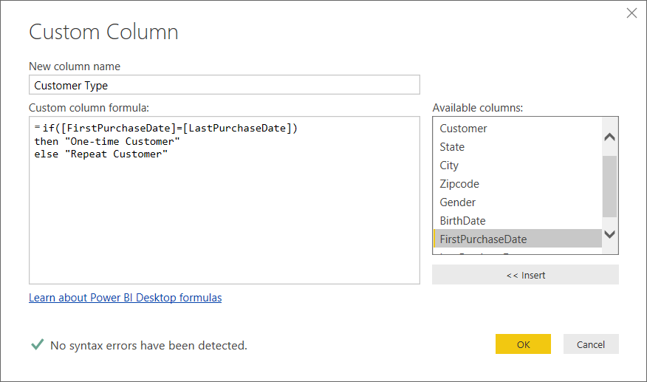
Custom Column Dialog
You can write M code directly for custom column
The Custom Column dialog provides a simple M code editor

Slide 10
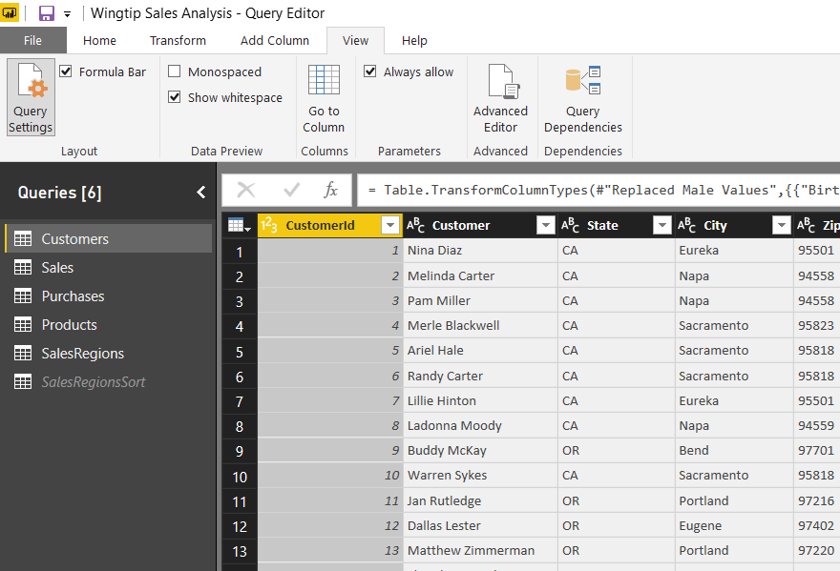
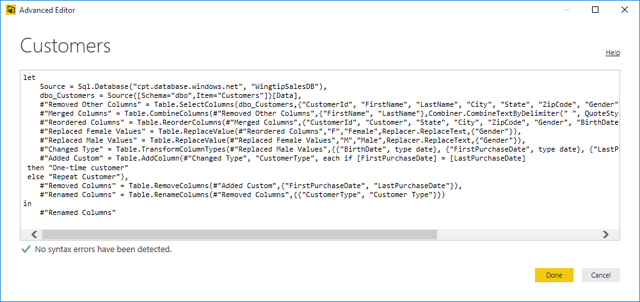
Advanced Editor or more correctly - The Simple Editor for Advanced Users
Power BI Desktop based on "M" functional language
Query in Power BI Desktop saved as set of M statements in code
Query Editor generates code in M behind the scenes
Advanced users can view & modify query code in Advanced Editor

Slide 11
Why Should You Learn M Programming?
Accomplish things that cannot be done in query editor
Working with query functions
Performing calculations across rows
Navigate to SharePoint list by list title instead of GUID with the ID
Author queries and check them into source control system
Add query logic in .m files and store them in GitHub, TFS, etc.
Ensure query logic is the same across PBIX projects
Stay Ahead of the Pack and Win Admiration of Your Peers
People will think you are buddies with Chris Webb!

Slide 12

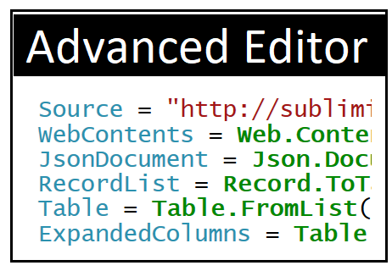
Why Should You Learn M Programming?
Take of the biggest of ELT challenges!

Slide 13
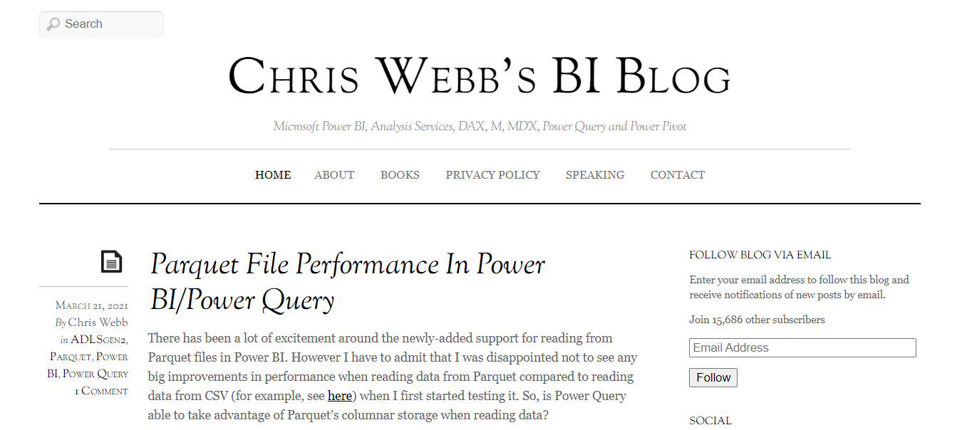
#1 Resource for Anyone Serious About Power Query
https://blog.crossjoin.co.uk

Slide 14
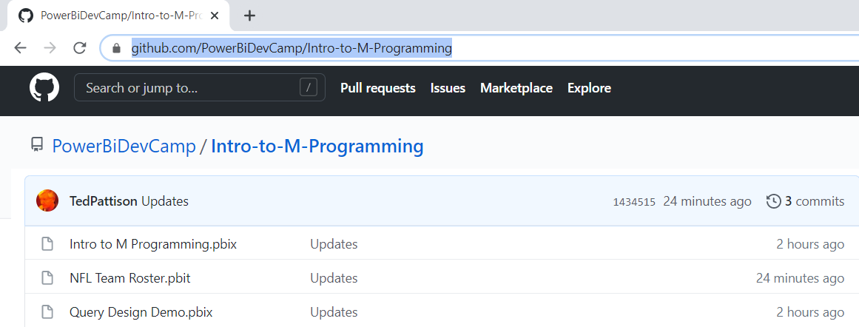
3 Sample Files Used in This Session
https://github.com/PowerBiDevCamp/Intro-to-M-Programming

Slide 15
Agenda
The Power Query Mashup Engine
M Programming Fundamentals
Programming Lists, Records and Tables
Understanding Query Folding
Choosing Between OData.Feed & Web.Contents
Writing Reusable Function Queries
Designing with Query Parameters

Slide 16
The M Programming Language
M is a functional programming language
computation through evaluation of mathematical functions
Programming involves writing expressions instead of statements
M does not support changing-state or mutable data
Every query is a single expression that returns a single value
Every query has a return type
Get Started with M
Language is case-sensitive
It's all about writing expressions
Query expressions can reference other queries by name

Slide 17
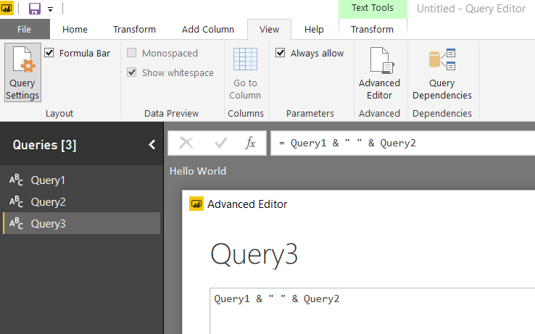
Referencing Other Queries
Query can reference other queries by name
Every query is defined with a return type

Slide 18
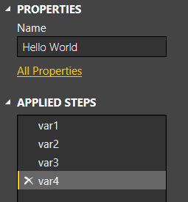
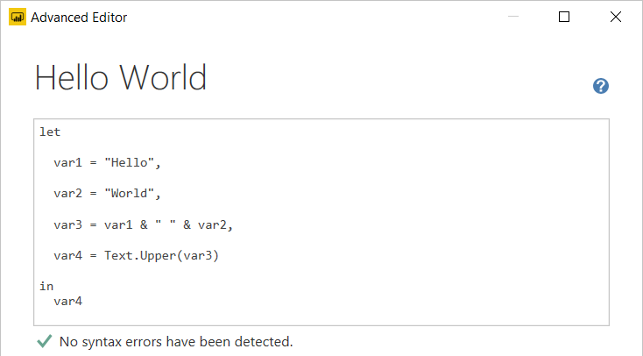
Let Statement
Queries usually created using let statement
Allows a single expressions to contain inner expressions
Each line in let block represents a separate expression
Each line in let block has variable which is named step
Each line in let block requires comma at end except for last line
Expression inside in block is returned as let statement value

Slide 19
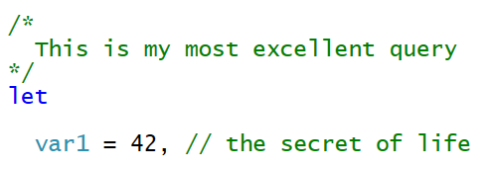
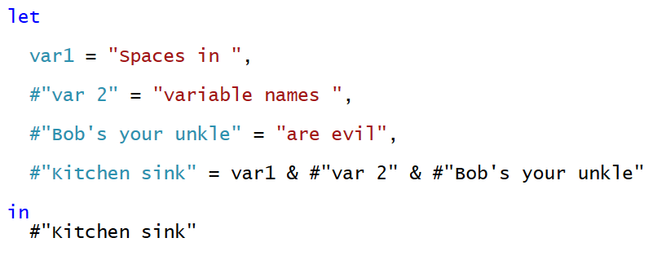
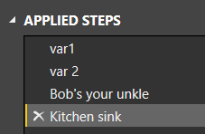
Comments and Variable Names
M supports using C-style comments
Multiline comments created using /* */
Single line comments created using //
Variable names with spaces must be enclosed in #" "
Variable names with spaces created automatically by query designer

Slide 20
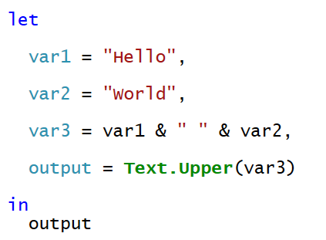
Flow of Statement Evaluation
Evaluation starts with expression inside in block
Expression evaluation triggers other expression evaluation

Slide 21
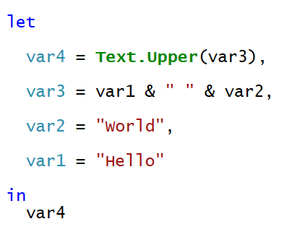
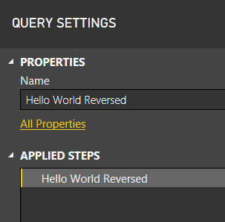
Will This M Code Work?
Yes, the Mashup Engine has no problem with this
The order of expressions in let block doesn't matter
However, the Power Query designer might get confused

Slide 22
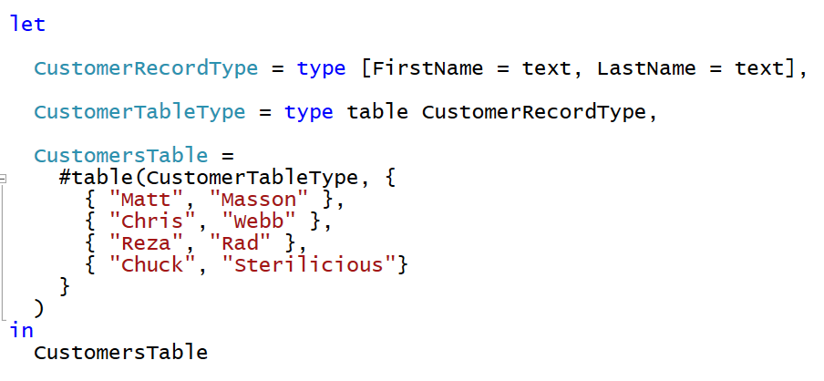
M Type System
Built-in types
any, none
null, logical, number, text, binary
time, date, datetime, datetimezone, duration
Complex types
list, record, table, function
User-defined types
You can create custom types for records and tables

Slide 23
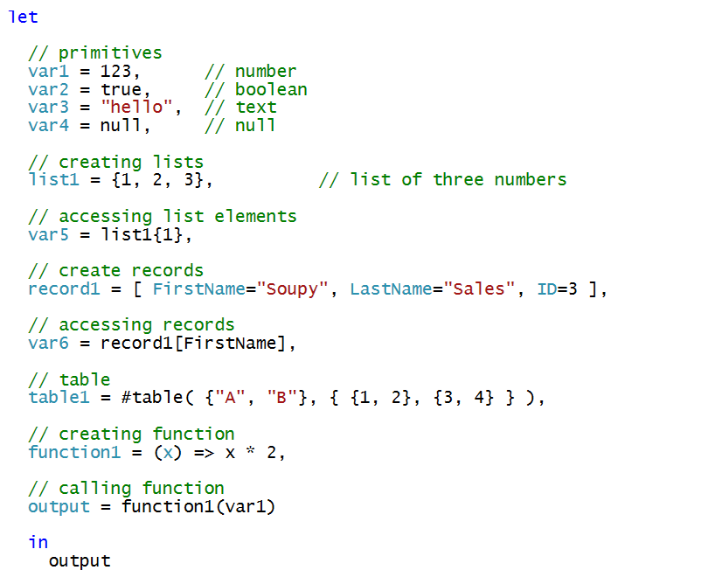
Examples of programming with M Datatypes

Slide 24
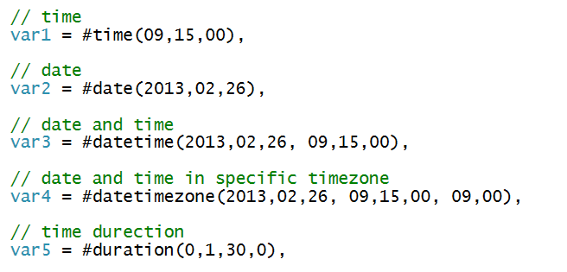
Initializing Dates and Times

Slide 25
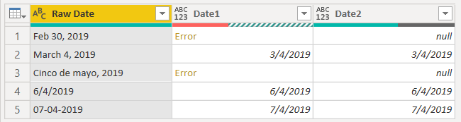
Catching Errors
Error handling in M done using try .. otherwise
Error handling can avoid evaluation errors
Expression causing errors replace with value such as null

Slide 26
Agenda
The Power Query Mashup Engine
M Programming Fundamentals
Programming Lists, Records and Tables
Understanding Query Folding
Choosing Between OData.Feed & Web.Contents
Writing Reusable Function Queries
Designing with Query Parameters

Slide 27
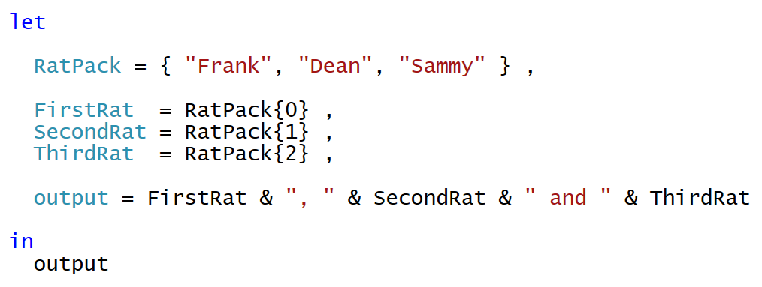
Lists
List is a single dimension array
Literal list can be created using { } operators
List elements accessed using { } operator and zero-based index
Use { }? to avoid error when index range is out-of-bounds

Slide 28
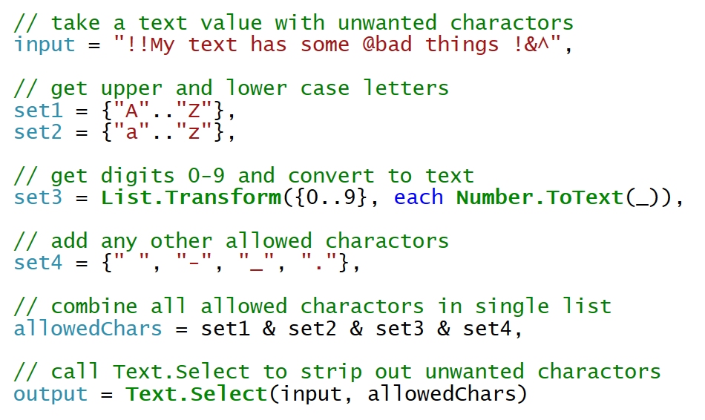
Text.Select
Text.Select can be used to clean up text value
You create a list of characters to include

Slide 29
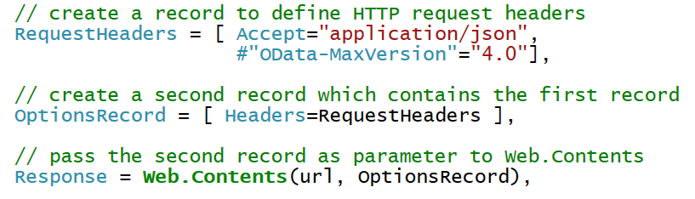
Records
Record contains fields for single instance of entity
You must often create records to call M library functions

Slide 30
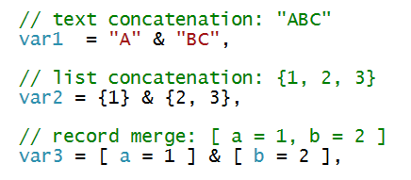
Combination Operator (&)
Used to combine strings, arrays and records

Slide 31
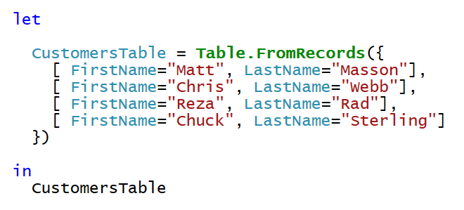
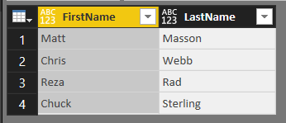
Table.FromRecords
Table.FromRecords can be used to create table
Table columns are not strongly typed
Bad, Bad, Bad ☹

Slide 32
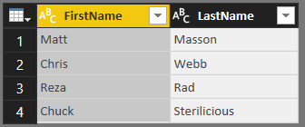
Creating User-defined Types
M allows you to create user-defined types
Here is a user-defined type for a record and a table
User-defined table used to create table with strongly typed columns

Slide 33
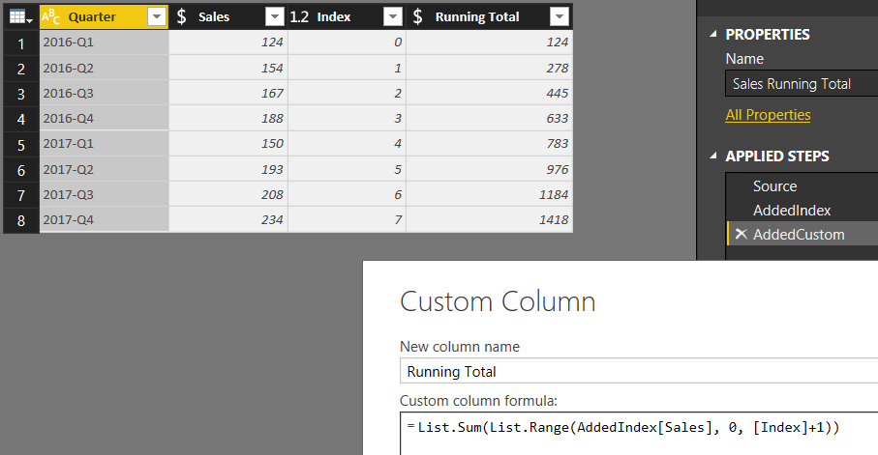
Performing Calculations Across Rows
Requires adding an index column

Slide 34

Using Each with Unary Functions
Many library functions take function as parameters
Function passed are often unary functions (e.g. they accept 1 parameter)
M provides each syntax to make code easier to read/write
Unary parameter passed implicitly using _ variable
You can omit _ variable when accessing fields inside record
You must use _ variable when using each with a list

Slide 35
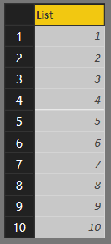
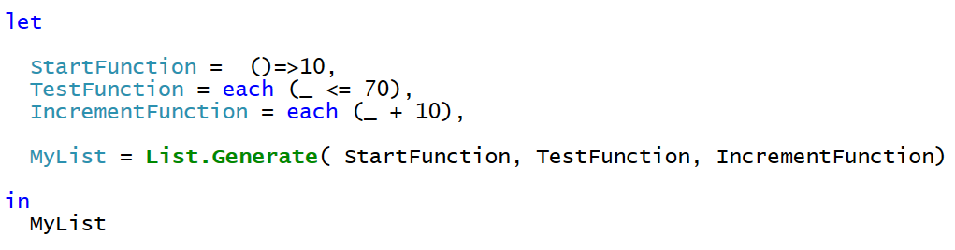
List.Generate
List.Generate accepts 3 function parameters
You can use each syntax for 2nd and 3rd parameter
You can optionally split functions out into separate expressions

Slide 36
Agenda
The Power Query Mashup Engine
M Programming Fundamentals
Programming Lists, Records and Tables
Understanding Query Folding
Choosing Between OData.Feed & Web.Contents
Writing Reusable Function Queries
Designing with Query Parameters

Slide 37
Query Folding
Mashup engine pushes work back to datasource when possible
Column selection and row filtering
Joins, Group By, Aggregate Operations
Datasource that support folding
Relational database
Tabular and multidimensional databases
OData Web services
What happens when datasource doesn't support query folding?
All work is done locally by the mashup engine
Things that affect whether query folding occurs
The way you structure your M code
Privacy level of datasources
Native query execution

Slide 38
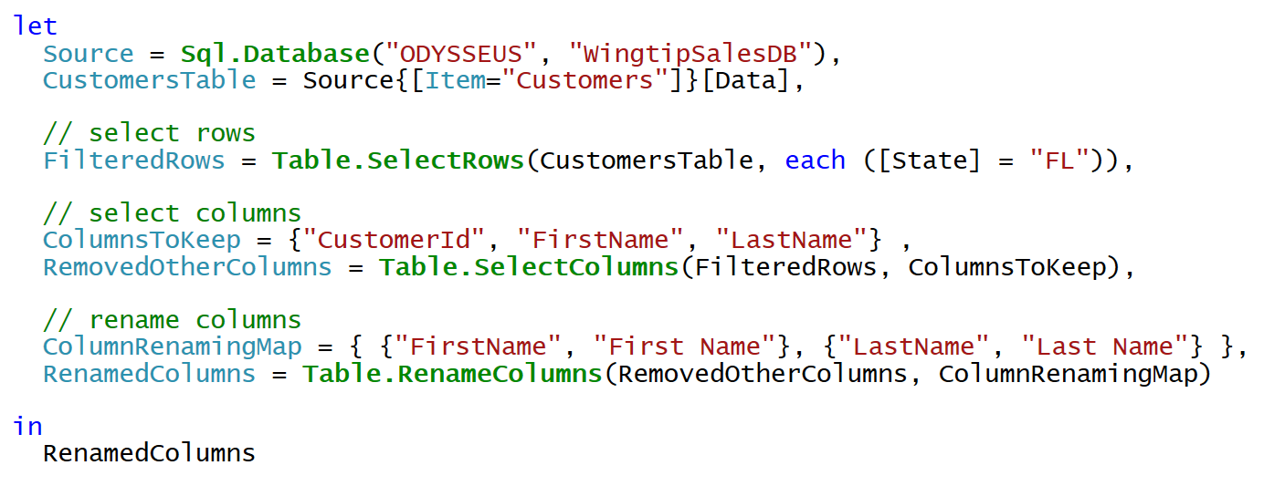
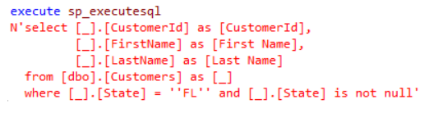
Query Folding Example
When you execute this query in Power BI Desktop…
Mashup Engine executes the following SQL query

Slide 39
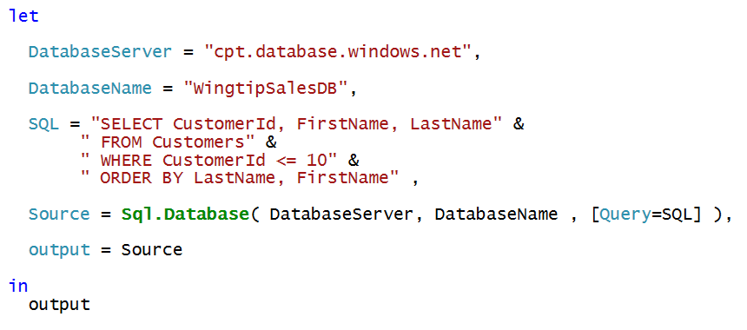
Native Queries
No query folding occurs after native query

Slide 40
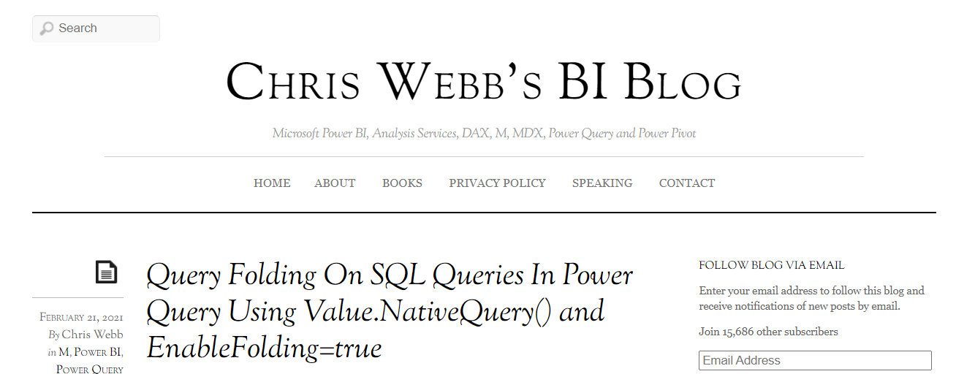
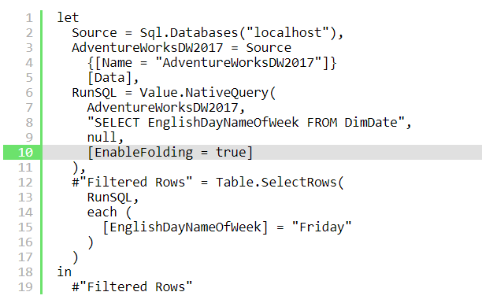

Slide 41
Agenda
The Power Query Mashup Engine
M Programming Fundamentals
Programming Lists, Records and Tables
Understanding Query Folding
Choosing Between OData.Feed & Web.Contents
Writing Reusable Function Queries
Designing with Query Parameters

Slide 42
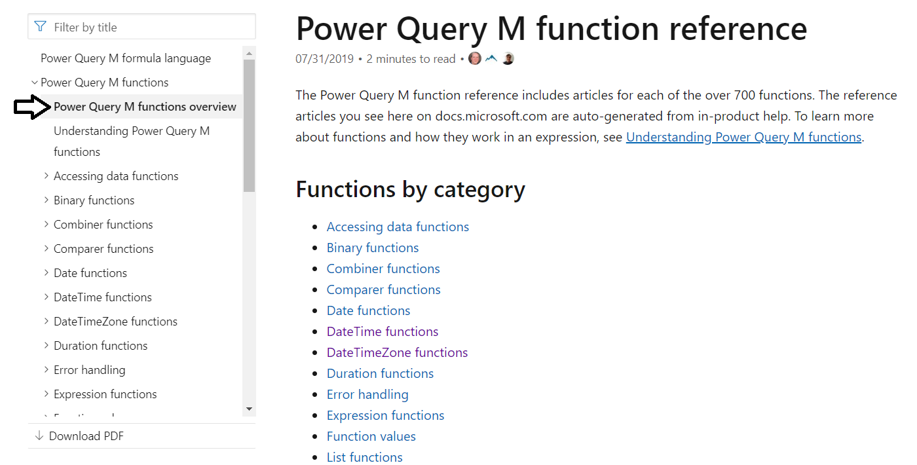
M Function Library
Check out the Power Query M function reference
https://docs.microsoft.com/en-us/powerquery-m/power-query-m-function-reference

Slide 43
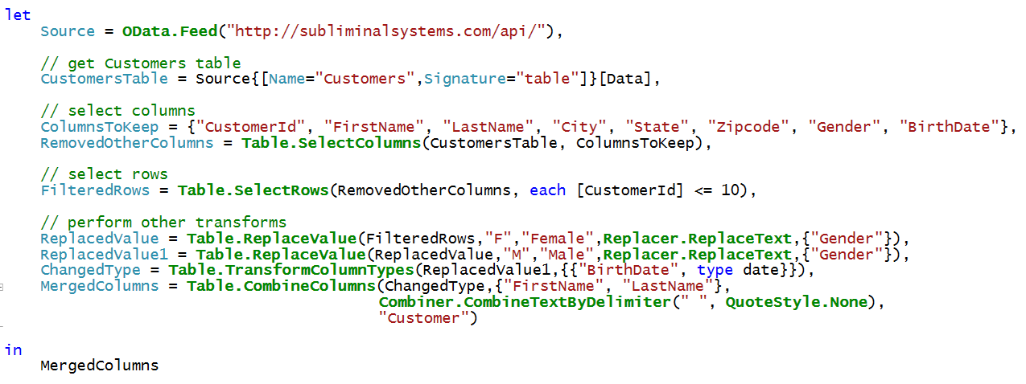
Accessing Data using OData.Feed
OData.Feed can pull data from OData web service
OData connector assists with navigation through entities
OData connector support query folding
OData makes extra calls to acquire metadata
Let's look at the execution of this query using Fiddler

Slide 44
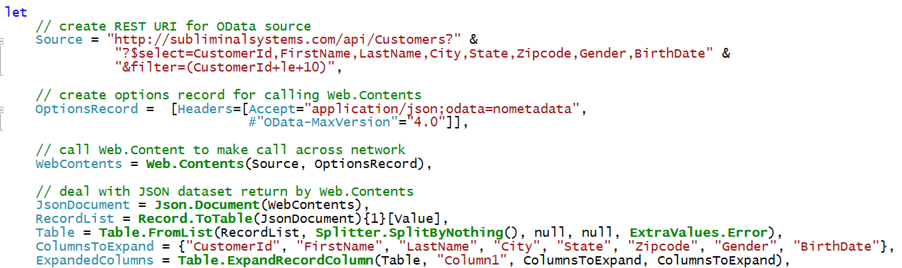
Web.Contents
Can be more efficient than OData.Feed
You can pass OData query string parameters (e.g. $select)

Slide 45
Agenda
The Power Query Mashup Engine
M Programming Fundamentals
Programming Lists, Records and Tables
Understanding Query Folding
Choosing Between OData.Feed & Web.Contents
Writing Reusable Function Queries
Designing with Query Parameters

Slide 46
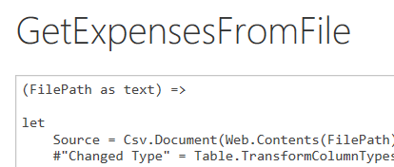
Understanding Function Queries
Query can be converted into reusable function
Requires editing query M code in Advanced Editor
Function query defined with one or more parameters
Function query can be called from other queries
Function query can be called using Invoke Custom Function
Function query can't be edited with visual designer

Slide 47
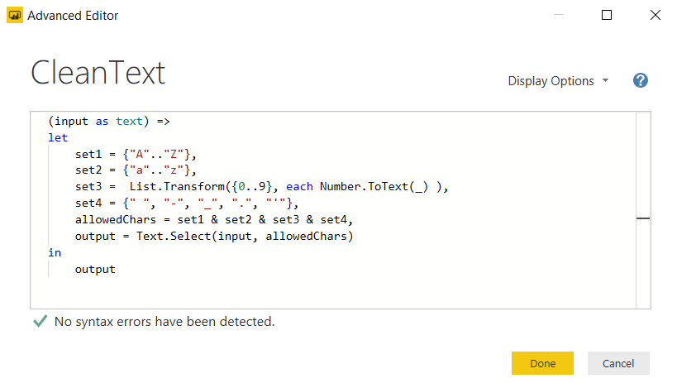
Creating a Function Query
Requires adding parameter list

Slide 48
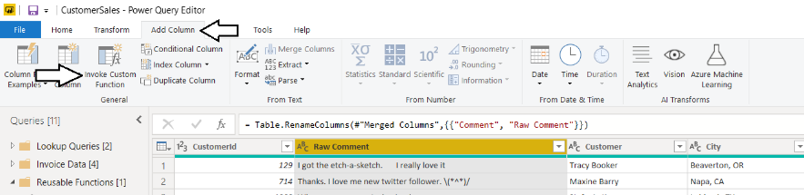
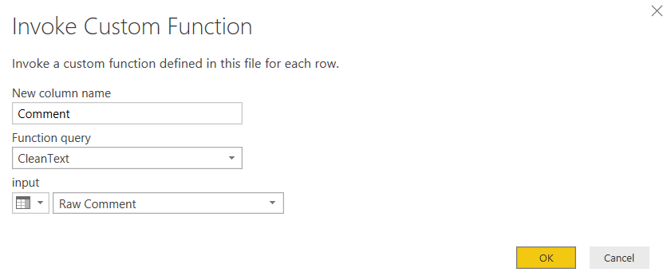
Calling a Function Query

Slide 49
Agenda
The Power Query Mashup Engine
M Programming Fundamentals
Programming Lists, Records and Tables
Understanding Query Folding
Choosing Between OData.Feed & Web.Contents
Writing Reusable Function Queries
Designing with Query Parameters

Slide 50
Query Parameters in Power BI Desktop
What is a Query Parameter?
Configurable setting for PBIX file
Strongly-typed value to which you can apply restrictions
Can be referenced from a query
Can be referenced from DAX code in data model
Query parameters can be updated in Power BI Service
Where are Parameters commonly used
To parameterize data source connection details
To filter rows when importing data
Commonly used together with Template Apps
Notes:
In the summer of 2016, the Power BI team added new support to Power BI Desktop so that you can create configurable parameters within the scope of a Power BI Desktop project. The two primary scenarios for creating project parameters is to parameterize data source settings and to parameterize filter criteria used in queries.

Slide 51
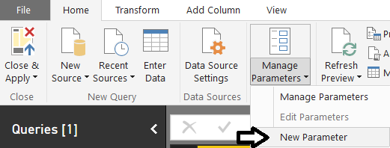
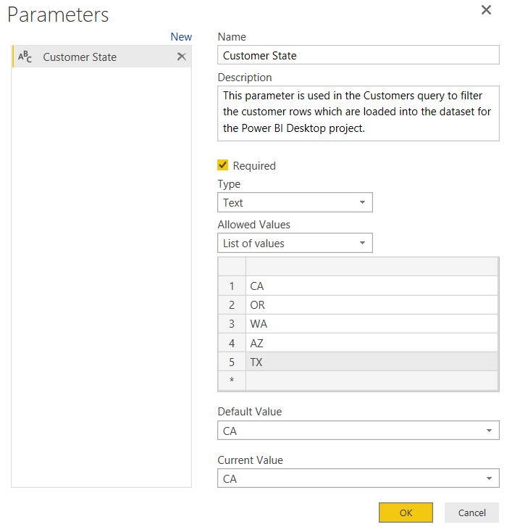
Creating Query Parameters
Parameters can be created using Manager Parameters menu
Parameter properties
Name
Description
Required
Allowed Values
Default Value
Current Value
Notes:
When you create a new parameter, you must give it a name and then you must configure its other properties. The Name property of a parameter is what you use when you need to reference the parameter. Each parameter has a Description property as well as a Required property and a Type which can be used to restrict the values which can be assigned to the parameter.
The Allowed Values property for a parameter provides even more control in configuring the allowed set of values for a given parameter. For instance, you can restrict the allowed values using a static list of values. The example show in the screenshot in the slides shows configuring a parameter to only accept values from a static list of states. . Users will then be able to pick one of these states when specifying the parameter value to use.
The Default Value property allows you to specify what the default value or selection should be used by default. The Current Value property allows you to specify the value that should be used for the parameter in the current report.

Slide 52


Referencing Parameters in a Query
Parameters can be referenced inside query
Next query execution uses current parameter value
Notes:
To use a parameter, you can reference it from one of the Power BI Desktop dialog boxes that allow you to configure data source settings or filter criteria in a query. However, you will find that many of the dialog boxes used by Power BI Desktop do not yet support configuring values using parameters. Over the next few months, the team that is updating Power BI desktop will continue to add support for using parameters to more of the application’s dialog boxes.

Slide 53

Updating Parameters in the Service

Slide 54

Making Parameters Available to Data Model
Configure parameter's Enable Load setting
Parameter becomes visible within fields list in report view
Notes:
Note that parameters, by default, are not visible within the project’s data model and cannot be used in visuals you add to reports or to the DAX expressions you write. However, you can configure the Enable Load property for a parameter to make it show up in the project’s data model. Once you have done this, the parameters will be visible to the project’s data model which can be handy when you are trying to parameterize values and lists of values that are displayed on a report.
In the example shown in the slide above, the Customer State parameter has been configured with the Enable Load property. Once a parameter has been configured with the Enable Load property, it appears in the project’s data model as a table with a field. This makes for a flexible design technique because it makes it possible to add a visual to a report that displays the parameter’s Current Value property. You can then update what is displayed on the report by simply updating the parameter’s Current Value property.

Slide 55




Power BI Project Template Files
PBIX project can be exported to project template file
Template file created with PBIT file extension
Generated template files contains everything except for the data
PBIT template file can be imported to create new PBIX projects
Template files are powerful when used together with parameters
How are template files used?
Export PBIX project to create a PBIT template file
Import the PBIT template file to create a new PBIX project
export
import
Notes:
About the time Microsoft added support to Power BI Desktop for creating parameters, they also added support for exporting the assets from a Power BI Desktop project to a specialized format for a project template file. A Power BI Desktop template file is like a PBIX file in that it is created as a ZIP archive using the Open Packaging Convention. You create a project template file by running the Export > Power BI Template command from the File menu. When you run the Export command, Power Bi Desktop creates the project template file by exporting assets from the PBIX file including the query definitions, the data source settings, the data modeling definitions for calculated columns and measures as well as the project’s report definition.
A Power BI Desktop project template file has a few important differences when compared to a PBIX file. First, a project template file has a file extension of PBIT instead of PBIX. Second, the project template file contains never contains any rows of data. The key idea is that exporting a project to a project template file copies everything you need except for the data itself. Therefore, PBIT files are often very small in size when compared to PBIX files. When you run the Import > Power BI Template command to import the project template file and create a new Power BI Desktop project from a PBIT template file, that is when Power BI Desktop will import the data.
Template files can be especially powerful when used together with project parameters. For example, imagine you have created a complete BI solution with a Power BI Desktop project that connects to a SQL Server database in a development environment. You can choose to create a parameter to configure the data source settings so that your project does not include hardcoded data source settings to your development database. Next, you can export the PBIX project to create a PBIT project template file containing all the definitions you have created for queries, calculated columns, measures and reports. This parameterized approach makes it easier when you deploy your custom solution to multiple customer environments which will each be running their own separate instance of the SQL Server database. When you import a PBIT file that contains the data source parameter, you will be prompted to enter the data source details for that particular customer environment. After you have configured the data source settings parameter for the new project, Power BI Desktop will execute all your queries to fill the project’s data model with rows of data from the correct database for that customer environment.

Slide 56
Summary
The Power Query Mashup Engine
M Programming Fundamentals
Programming Lists, Records and Tables
Understanding Query Folding
Choosing Between OData.Feed & Web.Contents
Writing Reusable Function Queries
Designing with Query Parameters

Slide 57
Microsoft Power BI
Questions?

